Slide 1
Becoming an Internet Hard Target: A Hacker’s Perspective
Derek Rook

Slide 2
Disclaimer
Views and opinions are my own and do not necessarily reflect those of my employer
Do not do anything on any computer for which you do not have express permission

Slide 3
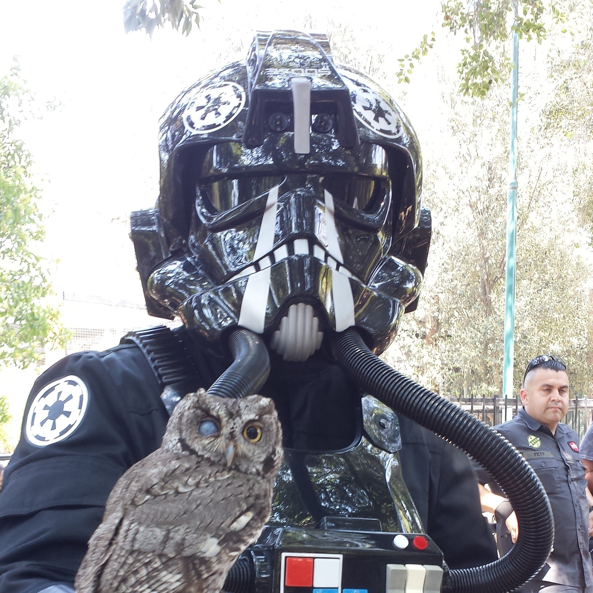
A Little About Me…
White Hat Hacker
Security Educator
15 year tech career
501st Legion Member
Practice Kendo
Notes:
A little about myself
Currently employed as a white hat hacker (we’ll get to what the means in a minute)
I’m a security educator. I present talks at various security focused conferences, as well as community talks like this one. Additionally I create educational videos on youtube to help explore various security topics.
I’ve been a little all over the map in technology, spanning 15 years across multiple disciplines
When I’m not being a cyber super hero I donate my time as a member of the 501st legion, and I practice Kendo, which is a japanese martial art focusing on the sword.

Slide 4
Offensive Security…what is it?
Use malicious tactics to discover and understand potential flaws
Apply malicious tactics legally and ALWAYS with permission
Leverage the perspective to learn and increase overall security

Slide 5
My Social Media got hacked? (Facebook, Twitter)
Very rarely is it the company that got hacked
Generally the user performed some action
Damages
Perform a single action
Partial account access
Full account access

Slide 6
A major company got breached
Usually due to a persistent threat
Originates much like a personal compromise
Damages
Loss of trade secrets
Damage to corporate reputation
Asset theft
Employee private information leakage

Slide 7
<Desktop Hacking Demo>

Slide 8
Let’s talk about P@$$w0rdz!

Slide 9
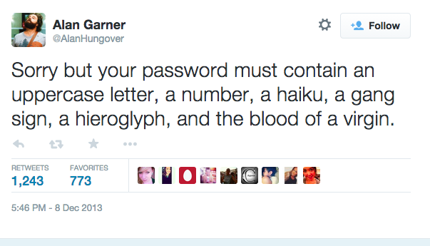

Slide 11
Upgrading to passphrases
Use a phrase of multiple words
Describe a favorite character, theme, or song in your own words
Easy to remember, and complex
Use it everywhere…..?

Slide 12
<SQL Injection Demo>

Slide 13


Slide 15
Credential Managers

Slide 16
Credential Managers
Cloud syncing
LastPass
1Password
Local program
KeePass

Slide 17
Benefits of credential managers
Only memorize 3-4 passphrases at a time
Unique random passwords for anything else
You don’t even need to know what those are
Devices sync through the cloud (usually a paid feature)

Slide 18
So what’s the catch?
There is some up front effort to get your accounts in there
Need to form different habits
Not 100% free (though usually pretty cheap)

Slide 19
Adding a site

Slide 20
Update existing site

Slide 21
Generate random passwords for use

Slide 22
The next level…adding 2 Factor

Slide 23
Google Authenticator
Generates unique codes for accounts
Can’t login without it
Easy setup (enter a code or scan a bar code)

Slide 24
SMS Message

Slide 25
Popular services that support two factor
PayPal
Twitter
Facebook
Steam
EVERY CREDENTIAL MANAGER
Many banks
Blizzard
League of Legends
AppleID
Gmail
Amazon
AND MORE!

Slide 26
Thank You!
Derek Rook
https://r00k.io
https://twitter.com/_r00k_
https://youtube.com/derekrook
https://github.com/r00k5A58

